Slide 1
SMART RESTROOMS
Groupmate's- Muhammad Ahmed Khan
Ayyappan Prudhvi Raj

Slide 2
Data collection:
1)How was code prepared?
2)How did you check whether the code is working or not?
3)How did you setup the prototype to collect the data?
4)For how long the data was collected and where?

Slide 3
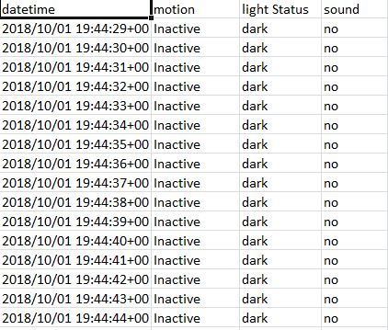
The data collected through prototype

Slide 4
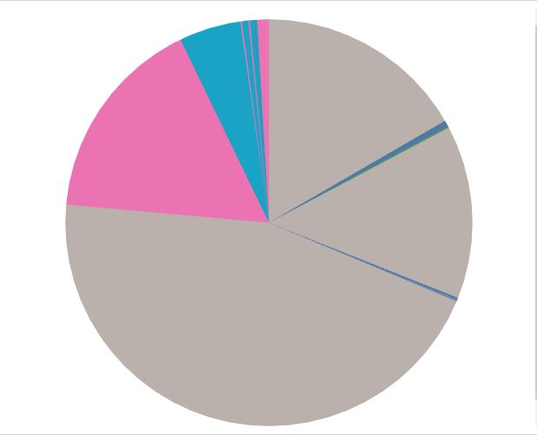
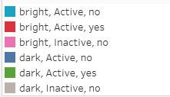
VISUALIZATION:

Slide 5
CHALLENGED FACED
1. Making code for the prototype.
2. Setting up the prototype.
3. Difficulties in collecting the data in required location.

Slide 6
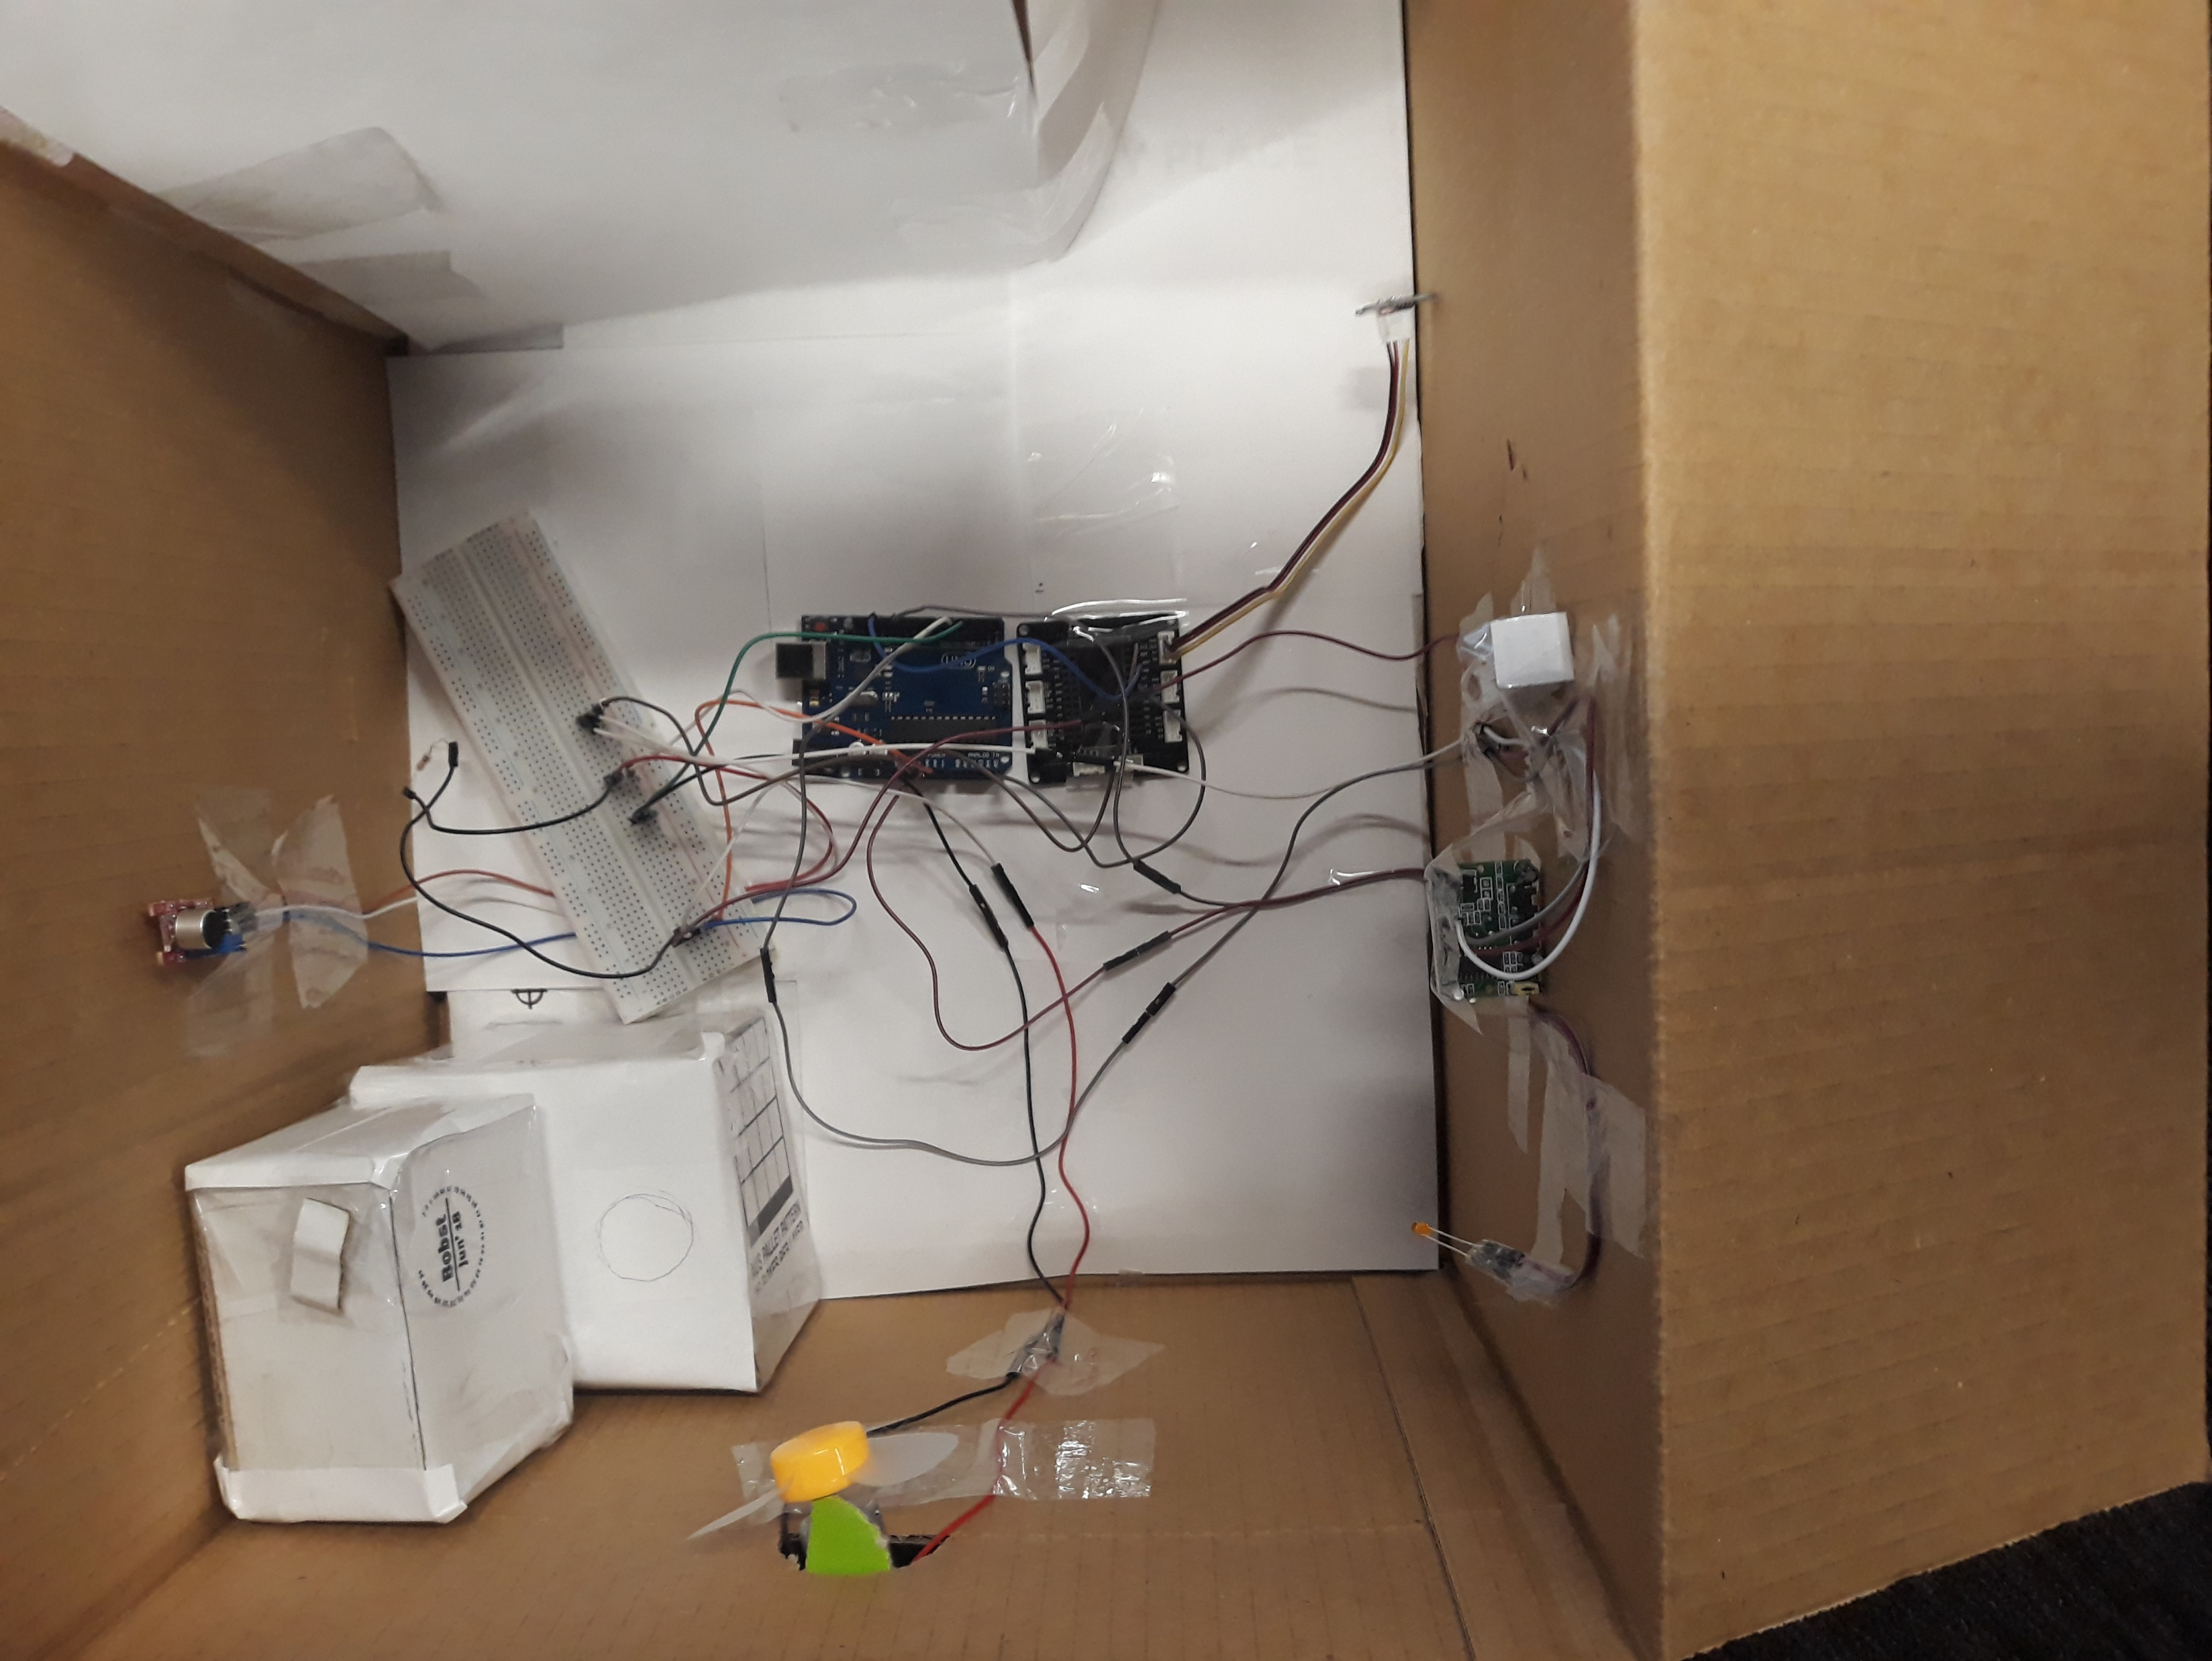
PROTOTYPE:

